Slide 1


MGCS-Energy Audit Company

Slide 2
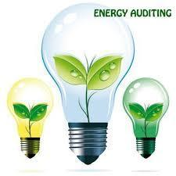
We conduct Energy Audit for all Electrical equipments, HVAC Equipments etc.

Slide 3
Major Components for Energy Audit
HVAC System
Building Structure
Lightning Distribution
Motors
Process Equipment
Boilers, Steam Furnaces

Slide 4
Electrical Audit System:
To study efficiency of Electrical Equipments like Transformers, Motors, Pumps, Compressor etc.
To study efficiency of consumables like UPS, Capacitor etc.
To check on voltage regulation
To check on validation of cable sizing
To check on efficiency of HVAC Systems

Slide 5
Thermal Audit System:
To study efficiency of Thermal Equipments like Boilers, DG etc.
To check on steam leakage
To check on steam trap assessment
To check on thermal insulation
To check on efficiency of thermal devices of HVAC Systems

Slide 6
Power Quality Harmonic Audit
Specialize in Power Management and conduct audit to make electrical, hydraulic and mechanical power operate more efficiently as per ASHRAE Level2 energy audit by using highly efficient power
Analyzer.

Slide 7
Get Energy Audit done now
Manage Energy Use
Reduce your Energy Consumption
Lower your Energy Bills
Prevent Voltage Fluctuations

Slide 8
MGCS professional audit can help in:
Reducing your energy bills
Correction Power Quality Issues
Managing Energy Consumption
Safety from Electrical Hazards
Energy Conservation for future

Slide 9
We have got BEE (Bureau of Energy Efficiency) Certified Energy Auditors on board to help you on Energy Management System
We use all gadgets and instruments from leading brands across the globe for fine accuracy and precision

Slide 10
Energy Conservation-need of the hour
Contact us now & save on Energy & Money
Write us at hina.gupta@mgcs.net.in for any query
L -011-49040941/42/43

